Slide 1
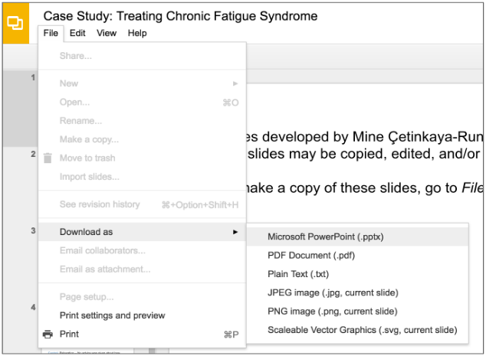
Slides developed by Mine Çetinkaya-Rundel of OpenIntro.
Translated from LaTeX to Google Slides by Curry Hilton of OpenIntro.
The slides may be copied, edited, and/or shared via the CC BY-SA license.
To make a copy of these slides, go to File > Download as > [option], as shown below. Or if you are logged into a Google account, you can choose Make a copy... to create your own version in Google Drive.

Slide 2
Case Study:
Gender Discrimination

Slide 3
Gender Discrimination
In 1972, as a part of a study on gender discrimination, 48 male bank supervisors were each given the same personnel file and asked to judge whether the person should be promoted to a branch manager job that was described as “routine”.
The files were identical except that half of the supervisors had files showing the person was male while the other half had files showing the person was female.
It was randomly determined which supervisors got “male” applications and which got “female” applications.
Of the 48 files reviewed, 35 were promoted.
The study is testing whether females are unfairly discriminated against.
Is this an observational study or an experiment?
B.Rosen and T. Jerdee (1974), ``Influence of sex role stereotypes on personnel decisions", J.Applied Psychology, 59:9-14.

Slide 4
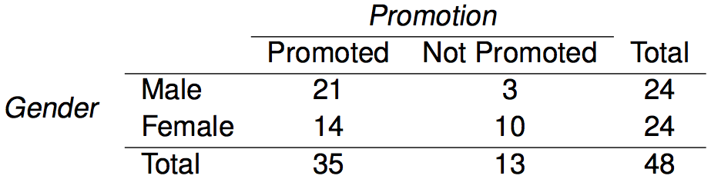
Data
At a first glance, does there appear to be a relationship between promotion and gender?

Slide 5
Data
At a first glance, does there appear to be a relationship between promotion and gender?
% of males promoted: 21 / 24 = 0.875
% of females promoted: 14 / 24 = 0.583

Slide 6
Practice
We saw a difference of almost 30% (29.2% to be exact) between the proportion of male and female files that are promoted. Based on this information, which of the below is true?
If we were to repeat the experiment we will definitely see that more female files get promoted. This was a fluke.
Promotion is dependent on gender, males are more likely to be promoted, and hence there is gender discrimination against women in promotion decisions.
The difference in the proportions of promoted male and female files is due to chance, this is not evidence of gender discrimination against women in promotion decisions.
Women are less qualified than men, and this is why fewer females get promoted.

Slide 7
Practice
We saw a difference of almost 30% (29.2% to be exact) between the proportion of male and female files that are promoted. Based on this information, which of the below is true?
If we were to repeat the experiment we will definitely see that more female files get promoted. This was a fluke.
Promotion is dependent on gender, males are more likely to be promoted, and hence there is gender discrimination against women in promotion decisions. Maybe
The difference in the proportions of promoted male and female files is due to chance, this is not evidence of gender discrimination against women in promotion decisions. Maybe
Women are less qualified than men, and this is why fewer females get promoted.

Slide 8
Two Competing Claims
“There is nothing going on.”
Promotion and gender are independent, no gender discrimination, observed difference in proportions is simply due to chance.
→ Null Hypothesis

Slide 9
Two Competing Claims
“There is nothing going on.”
Promotion and gender are independent, no gender discrimination, observed difference in proportions is simply due to chance.
→ Null Hypothesis
“There is something going on.”
Promotion and gender are dependent, there is gender discrimination, observed difference in proportions is not due to chance.
→ Alternative Hypothesis

Slide 10
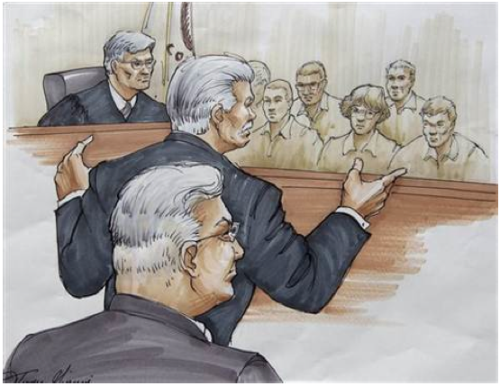
A Trial as a Hypothesis Test
Hypothesis testing is very much like a court trial.
H₀ : Defendant is innocent H_{A} : Defendant is guilty
We then present the evidence - collect data.
Then we judge the evidence - “Could these data plausibly have happened by chance if the null hypothesis were true?"
If they were very unlikely to have occurred, then the evidence raises more than a reasonable doubt in our minds about the null hypothesis.
Ultimately we must make a decision. How unlikely is unlikely?
Image from http://www.nwherald.com/_internal/cimg!0/oo1il4sf8zzaqbboq25oevvbg99wpot

Slide 11
A Trial as a Hypothesis Test (cont.)
If the evidence is not strong enough to reject the assumption of innocence, the jury returns with a verdict of “not guilty".
The jury does not say that the defendant is innocent, just that there is not enough evidence to convict.
The defendant may, in fact, be innocent, but the jury has no way of being sure.
Said statistically, we fail to reject the null hypothesis.
We never declare the null hypothesis to be true, because we simply do not know whether it's true or not.
Therefore we never ``accept the null hypothesis".

Slide 12
A Trial as a Hypothesis Test (cont.)
In a trial, the burden of proof is on the prosecution.
In a hypothesis test, the burden of proof is on the unusual claim.
The null hypothesis is the ordinary state of affairs (the status quo), so it's the alternative hypothesis that we consider unusual and for which we must gather evidence.

Slide 13
Recap: Hypothesis Testing Framework
We start with a null hypothesis (H0) that represents the status quo.
We also have an alternative hypothesis (HA) that represents our research question, i.e. what we're testing for.
We conduct a hypothesis test under the assumption that the null hypothesis is true, either via simulation (today) or theoretical methods (later in the course).
If the test results suggest that the data do not provide convincing evidence for the alternative hypothesis, we stick with the null hypothesis. If they do, then we reject the null hypothesis in favor of the alternative.

Slide 14
Simulating the experiment...
... under the assumption of independence, i.e. leave things up to chance.
If results from the simulations based on the chance model look like the data, then we can determine that the difference between the proportions of promoted files between males and females was simply due to chance (promotion and gender are independent).
If the results from the simulations based on the chance model do not look like the data, then we can determine that the difference between the proportions of promoted files between males and females was not due to chance, but due to an actual effect of gender (promotion and gender are dependent).

Slide 15
Application Activity:
Simulating the Experiment
Use a deck of playing cards to simulate this experiment.
Let a face card represent not promoted and a non-face card represent a promoted. Consider aces as face cards.
Set aside the jokers.
Take out 3 aces >> there are exactly 13 face cards left in the deck (face cards: A, K, Q, J).
Take out a number card >> there are exactly 35 number (non-face) cards left in the deck (number cards: 2-10).
Shuffle the cards and deal them intro two groups of size 24, representing males and females.
Count and record how many files in each group are promoted (number cards).
Calculate the proportion of promoted files in each group and take the difference (male - female), and record this value.
Repeat steps 2 - 4 many times.

Slide 16
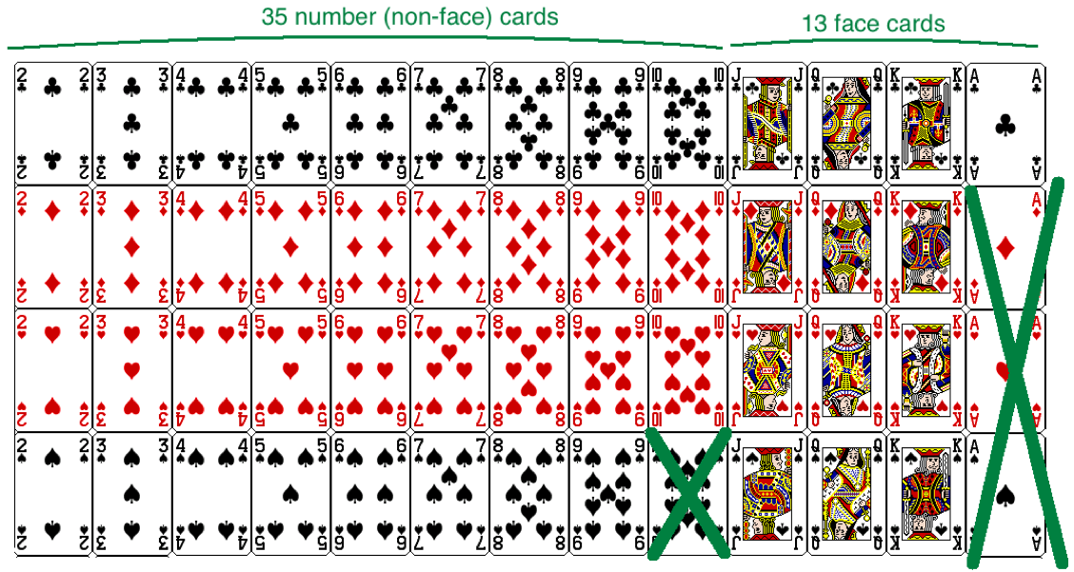
Step 1

Slide 17
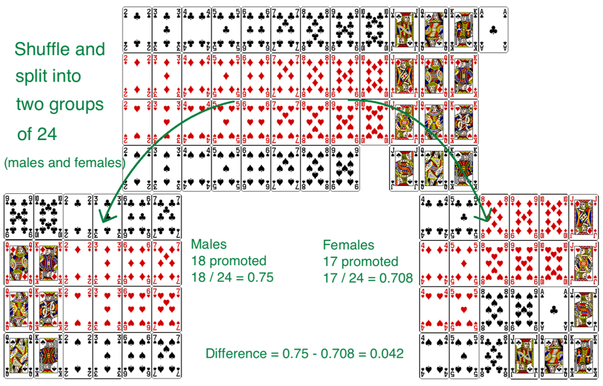
Step 2 - 4

Slide 18
Practice
Do the results of the simulation you just ran provide convincing evidence of gender discrimination against women, i.e. dependence between gender and promotion decisions?
No, the data do not provide convincing evidence for the alternative hypothesis, therefore we can't reject the null hypothesis of independence between gender and promotion decisions. The observed difference between the two proportions was due to chance.
Yes, the data provide convincing evidence for the alternative hypothesis of gender discrimination against women in promotion decisions. The observed difference between the two proportions was due to a real effect of gender.

Slide 19
Practice
Do the results of the simulation you just ran provide convincing evidence of gender discrimination against women, i.e. dependence between gender and promotion decisions?
No, the data do not provide convincing evidence for the alternative hypothesis, therefore we can't reject the null hypothesis of independence between gender and promotion decisions. The observed difference between the two proportions was due to chance.
Yes, the data provide convincing evidence for the alternative hypothesis of gender discrimination against women in promotion decisions. The observed difference between the two proportions was due to a real effect of gender.

Slide 20
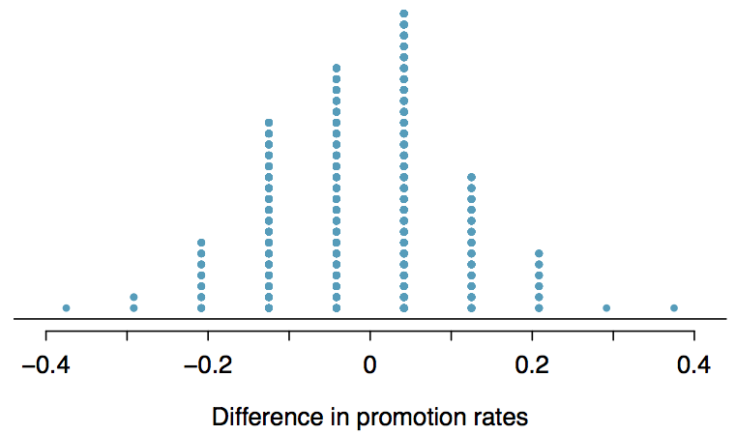
Simulations Using Software
These simulations are tedious and slow to run using the method described earlier. In reality, we use software to generate the simulations. The dot plot below shows the distribution of simulated differences in promotion rates based on 100 simulations.

Slide 21
Find more resources at openintro.org/os, including
Slides
Videos
Statistical Software Labs
Discussion Forums (free support for students and teachers)
Learning Objectives
Teachers only content is also available for Verified Teachers, including
Exercise solutions
Sample exams
Ability to request a free desk copy for a course
Statistics Teachers email group
Questions? Contact us.

